Slide 1
Gaussian Naïve Bayes Classifier (GNB)
Generative Classifiers

Slide 2
Gaussian Naïve Bayes Classifier
If the attributes are continuous, then each attribute is modeled as Gaussian distribution.

Slide 3
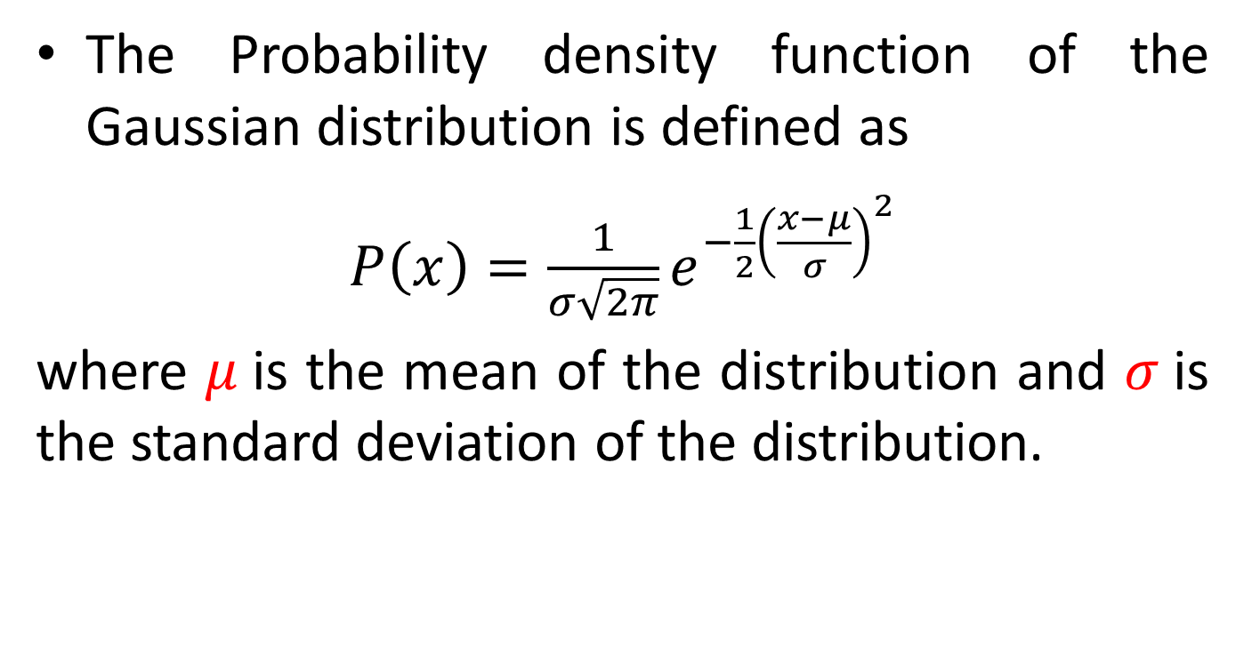
Gaussian Naïve Bayes Classifier
The Probability density function of the Gaussian distribution is defined as
$P\left(x\right)=\frac{1}{σ\sqrt{2π}}e^{−\frac{1}{2}{\left(\frac{x−μ}{σ}\right)}^{2}}$
where $μ$is the mean of the distribution and $σ$is the standard deviation of the distribution.

Slide 4
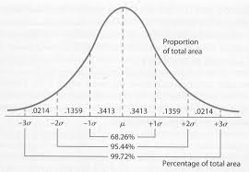
Gaussian Naïve Bayes Classifier

Slide 5
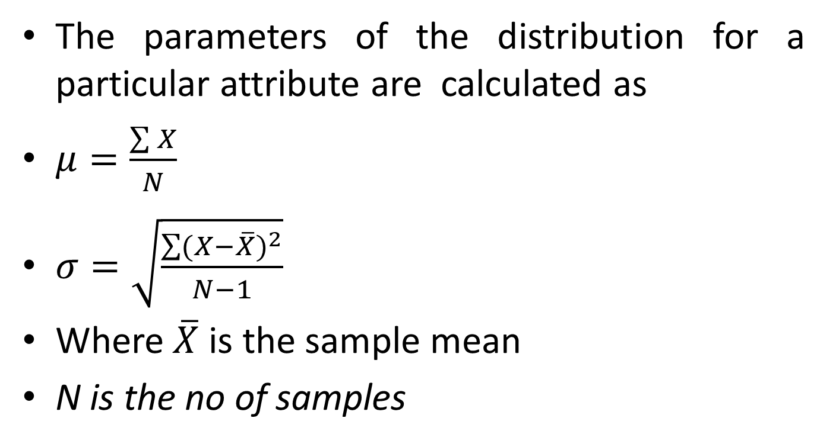
Gaussian Naïve Bayes Classifier
The parameters of the distribution for a particular attribute are calculated as
$μ=\frac{\sum{X}}{N}$
$σ=\sqrt{\frac{\sum{{(X−\overline{X})}^{2}}}{N−1}}$
Where $\overline{X}$ is the sample mean
N is the no of samples

Slide 6
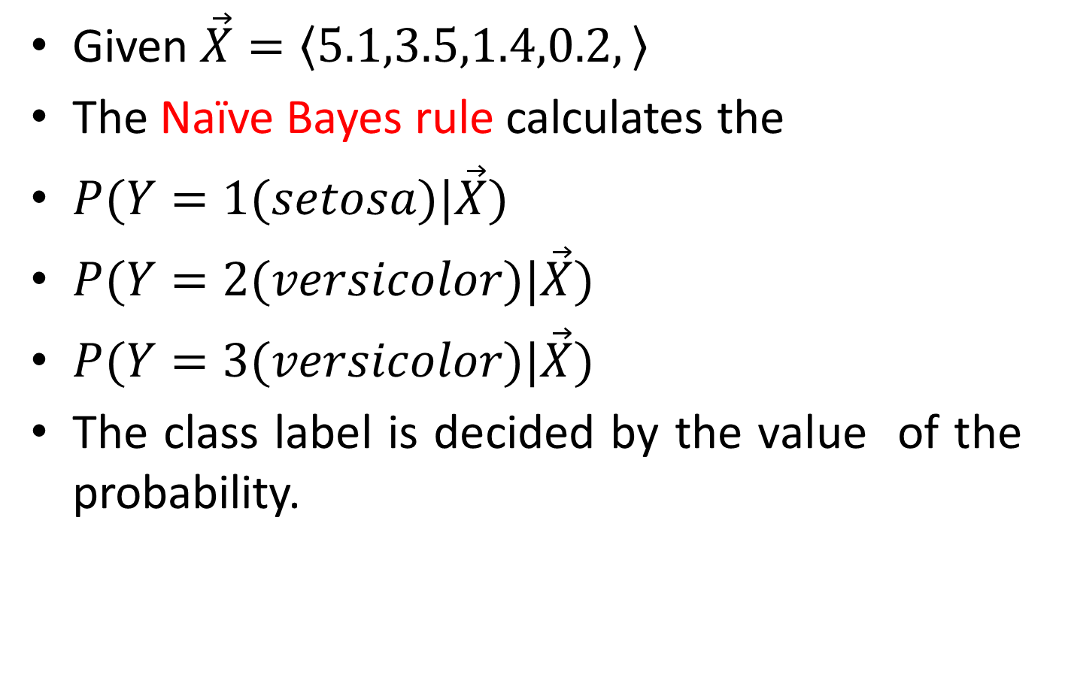
Gaussian Naïve Bayes Classifier
Given $\vec{X}=\left\langle 5.1,3.5,1.4,0.2,\right\rangle$
The Naïve Bayes rule calculates the
$P(Y=1(setosa)|\vec{X})$
$P(Y=2(versicolor)|\vec{X})$
$P(Y=3(versicolor)|\vec{X})$
The class label is decided by the value of the probability.

Slide 7
Gaussian Naïve Bayes Classifier
The training phase is simple and involves the computation of parameters of normal distribution model of each attribute conditioned on each target class.
The prior probabilities of the classes are also calculated.

Slide 8
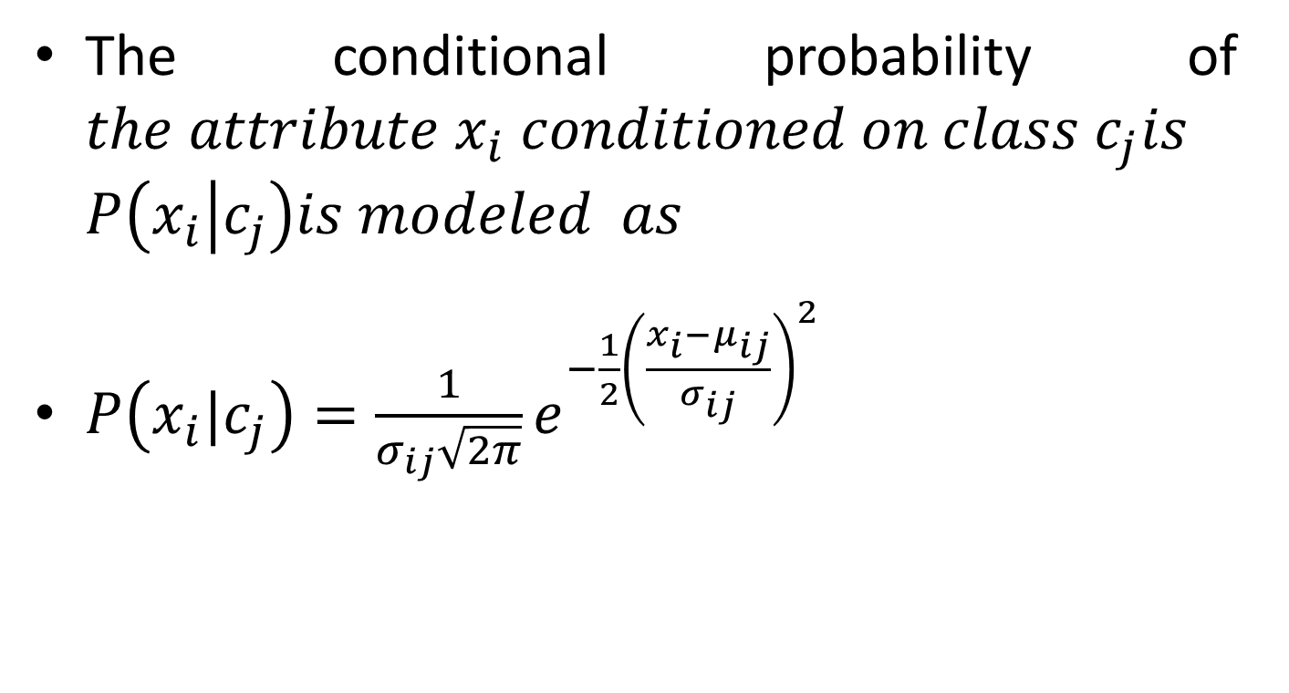
Gaussian Naïve Bayes Classifier
The conditional probability of $the attribute x_{i} conditioned on class c_{j}is$ $P\left(x_{i} | c_{j}\right)is modeled as$
$P\left(x_{i}|c_{j}\right)=\frac{1}{σ_{ij}\sqrt{2π}}e^{−\frac{1}{2}{\left(\frac{x_{i}−μ_{ij}}{σ_{ij}}\right)}^{2}}$

Slide 9
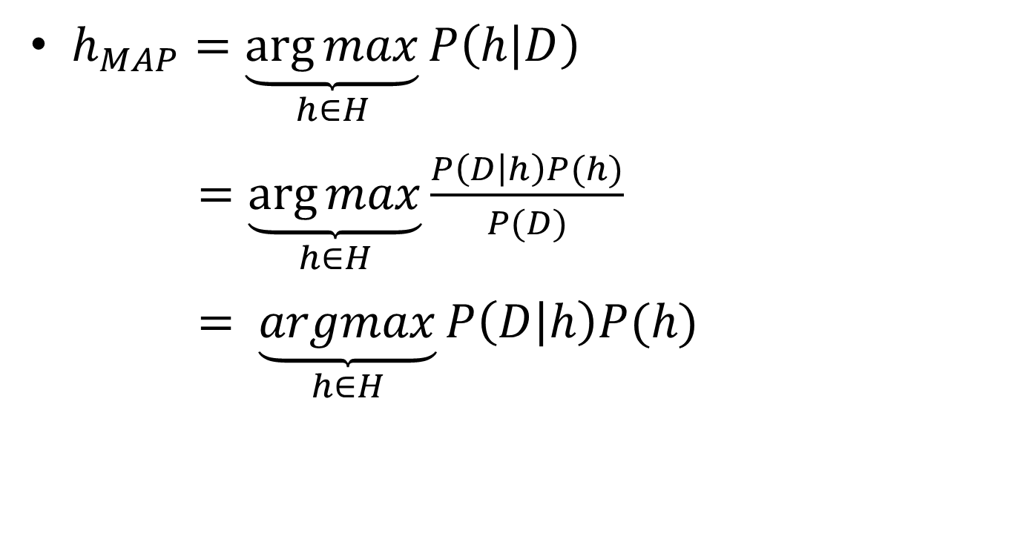
Gaussian Naïve Bayes Classifier
$h_{MAP}=\underset{h∈H}{\underbrace{\arg{max}}}P\left(h | D\right)$
$=\underset{h∈H}{\underbrace{\arg{max}}}\frac{P\left(D | h\right)P(h)}{P(D)}$
$= \underset{h∈H}{\underbrace{argmax}}P\left(D | h\right)P(h)$

Slide 10
Gaussian Naïve Bayes Classifier
Likelihood
Prior Probability
Posterior Probability

Slide 11
Naïve Bayes rule
Likelihood
Prior Probability
Posterior Probability
By Conditional independence, We assume that, features are independent which results in Naïve Bayes rule.

Slide 12
GNB classifier-Example
SL | PL | CLASS
5.4 | 1.7 | Setosa
4.6 | 1.4 | Setosa
5 | 1.5 | Setosa
4.4 | 1.4 | Setosa
4.9 | 1.5 | Setosa
6.1 | 4 | Versicolor
6.3 | 4.9 | Versicolor
6.1 | 4.7 | Versicolor
6.4 | 4.3 | Versicolor
6.6 | 4.4 | Versicolor
7.2 | 5.8 | Virginica
7.4 | 6.1 | Virginica
7.9 | 6.4 | Virginica
6.4 | 5.6 | Virginica
6.3 | 5.1 | Virginica

Slide 13
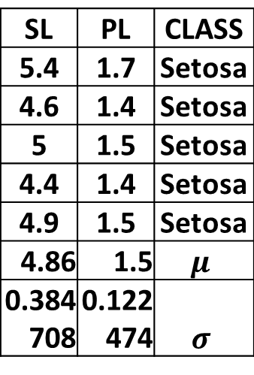
GNB classifier-Example
SL | PL | CLASS
5.4 | 1.7 | Setosa
4.6 | 1.4 | Setosa
5 | 1.5 | Setosa
4.4 | 1.4 | Setosa
4.9 | 1.5 | Setosa
SL | PL | CLASS
5.4 | 1.7 | Setosa
4.6 | 1.4 | Setosa
5 | 1.5 | Setosa
4.4 | 1.4 | Setosa
4.9 | 1.5 | Setosa
4.86 | 1.5 | $$μ$$
0.384708 | 0.122474 | $$σ$$

Slide 14
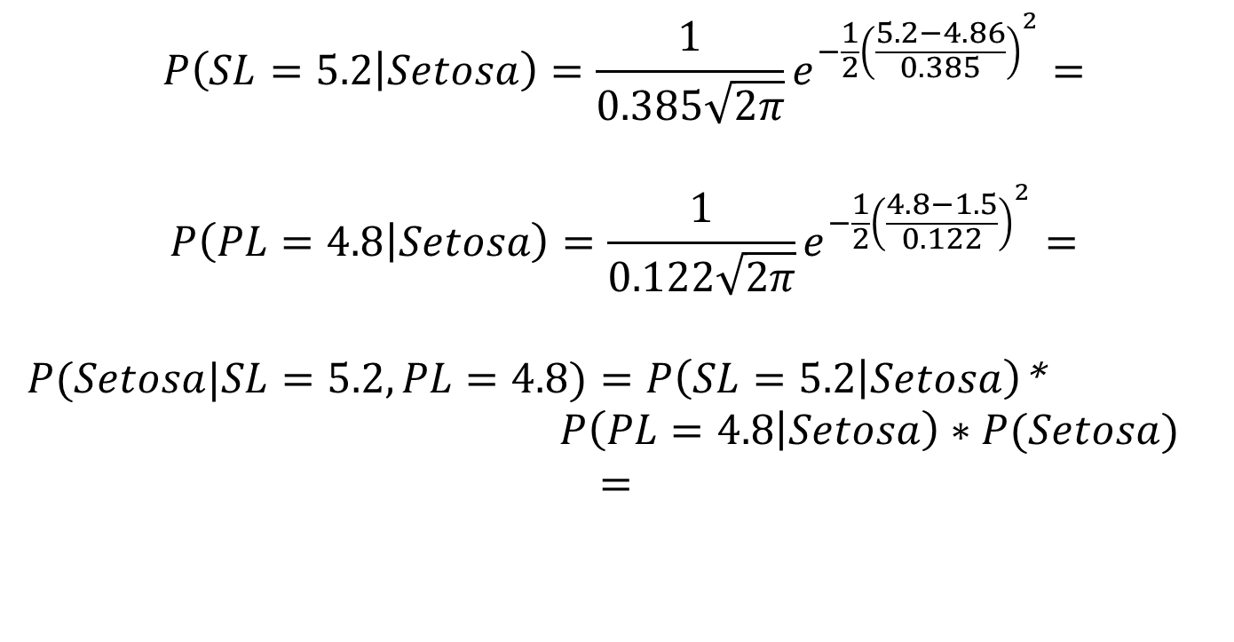
GNB classifier-Example
$$P\left(SL=5.2 | Setosa\right)=\frac{1}{0.385\sqrt{2π}}e^{−\frac{1}{2}{\left(\frac{5.2−4.86}{0.385}\right)}^{2}}=$$
$$P\left(PL=4.8 | Setosa\right)=\frac{1}{0.122\sqrt{2π}}e^{−\frac{1}{2}{\left(\frac{4.8−1.5}{0.122}\right)}^{2}}=$$
$P(Setosa|SL=5.2,PL=4.8)=P\left(SL=5.2 | Setosa\right)$*
$P\left(PL=4.8 | Setosa\right)∗P(Setosa)$
$=$

Slide 15
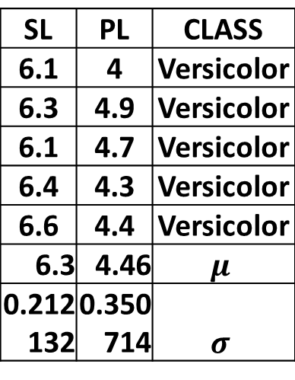
GNB classifier-Example
SL | PL | CLASS
6.1 | 4 | Versicolor
6.3 | 4.9 | Versicolor
6.1 | 4.7 | Versicolor
6.4 | 4.3 | Versicolor
6.6 | 4.4 | Versicolor
SL | PL | CLASS
6.1 | 4 | Versicolor
6.3 | 4.9 | Versicolor
6.1 | 4.7 | Versicolor
6.4 | 4.3 | Versicolor
6.6 | 4.4 | Versicolor
6.3 | 4.46 | $$μ$$
0.212132 | 0.350714 | $$σ$$

Slide 16
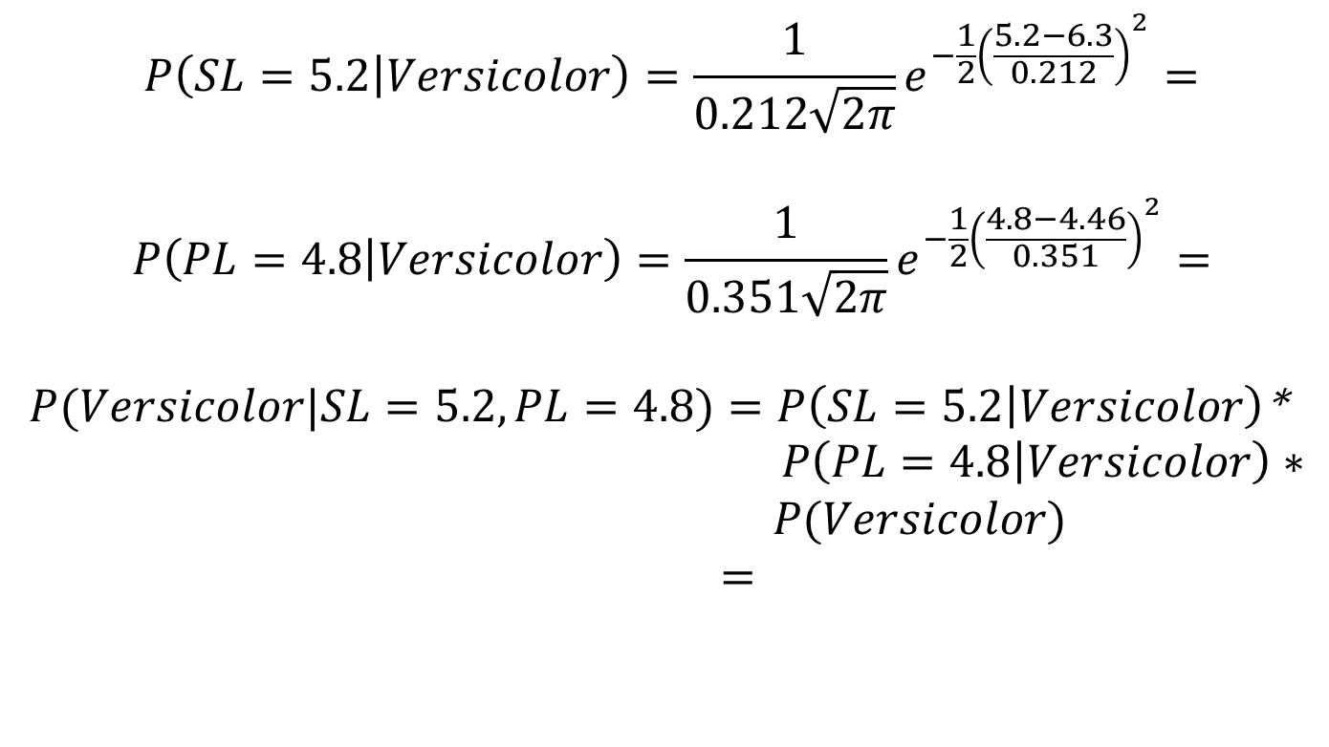
GNB classifier-Example
$$P\left(SL=5.2 | Versicolor\right)=\frac{1}{0.212\sqrt{2π}}e^{−\frac{1}{2}{\left(\frac{5.2−6.3}{0.212}\right)}^{2}}=$$
$$P\left(PL=4.8 | Versicolor\right)=\frac{1}{0.351\sqrt{2π}}e^{−\frac{1}{2}{\left(\frac{4.8−4.46}{0.351}\right)}^{2}}=$$
$P(Versicolor|SL=5.2,PL=4.8)=P\left(SL=5.2 | Versicolor\right)$*
$P\left(PL=4.8 | Versicolor\right)∗ P(Versicolor)$
$=$

Slide 17
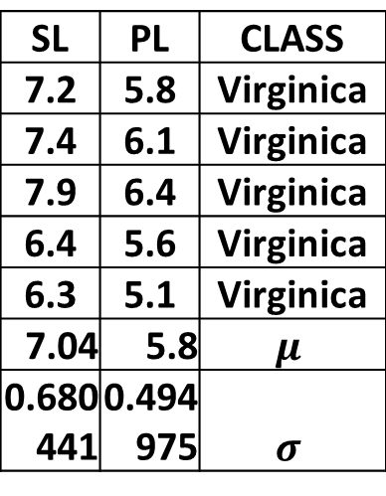
GNB classifier-Example
SL | PL | CLASS
7.2 | 5.8 | Virginica
7.4 | 6.1 | Virginica
7.9 | 6.4 | Virginica
6.4 | 5.6 | Virginica
6.3 | 5.1 | Virginica
SL | PL | CLASS
7.2 | 5.8 | Virginica
7.4 | 6.1 | Virginica
7.9 | 6.4 | Virginica
6.4 | 5.6 | Virginica
6.3 | 5.1 | Virginica
7.04 | 5.8 | $$μ$$
0.680441 | 0.494975 | $$σ$$

Slide 18
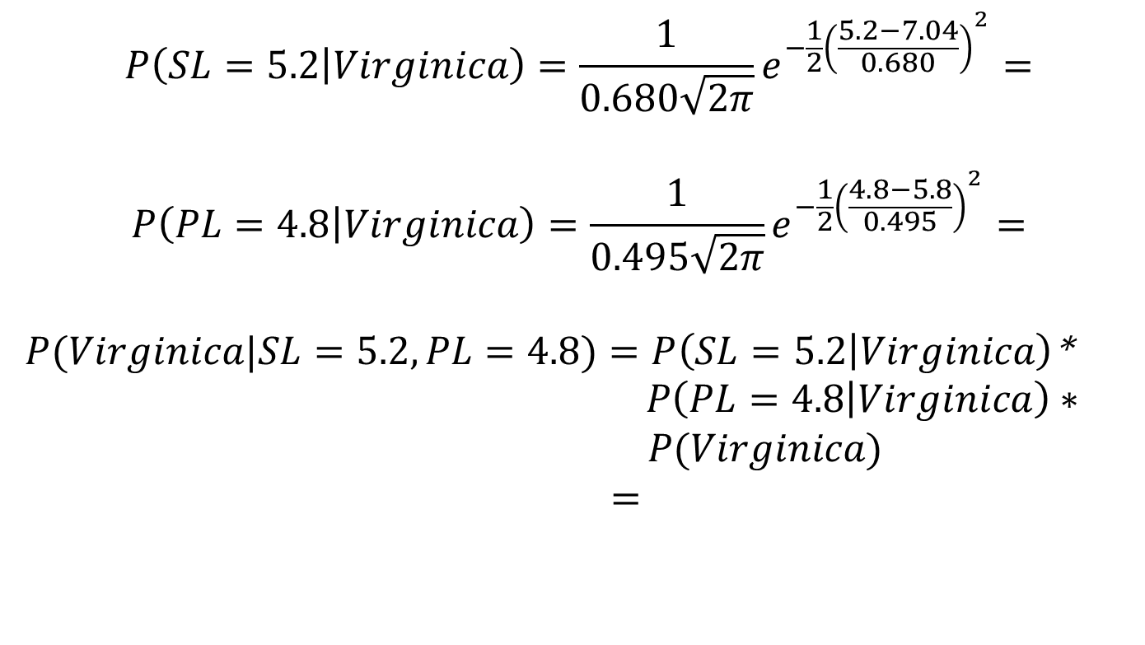
GNB classifier-Example
$$P\left(SL=5.2 | Virginica\right)=\frac{1}{0.680\sqrt{2π}}e^{−\frac{1}{2}{\left(\frac{5.2−7.04}{0.680}\right)}^{2}}=$$
$$P\left(PL=4.8 | Virginica\right)=\frac{1}{0.495\sqrt{2π}}e^{−\frac{1}{2}{\left(\frac{4.8−5.8}{0.495}\right)}^{2}}=$$
$P(Virginica|SL=5.2,PL=4.8)=P\left(SL=5.2 | Virginica\right)$*
$P\left(PL=4.8 | Virginica\right)∗ P(Virginica)$
$=$

Slide 19

Classify
$\overline{X}=\left\langle 5, 1.5\right\rangle$

Slide 20
GNB classifier-Example

